Slide 1
Topic : Circles
Term 4 – Week 4
Ms. Latham
Year 10 – Coordinate Geometry
EQ: How are circles graphed?

Slide 2
Overview
Understand the different parts of a circles equation
How the different parts will transform when graphed
Students will need a half page of graph paper

Slide 3
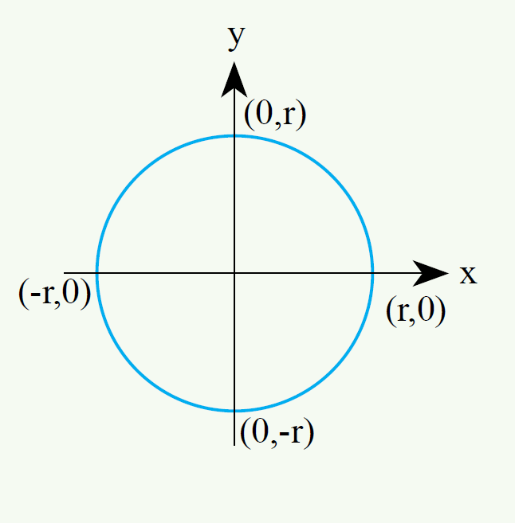
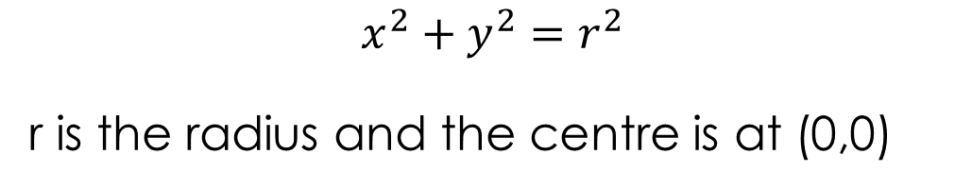
Topic : Circles
How are circles graphed?
radius
The distance from the centre of the circle to a point on the circle
(½ the diameter)
equation
$$x^{2}+y^{2}=r^{2}$$
r is the radius and the centre is at (0,0)

Slide 4
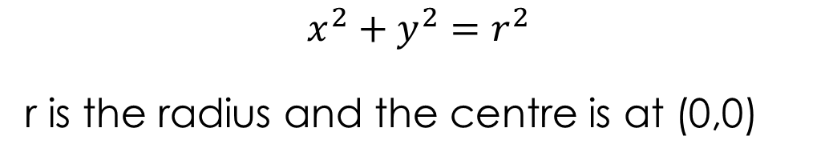
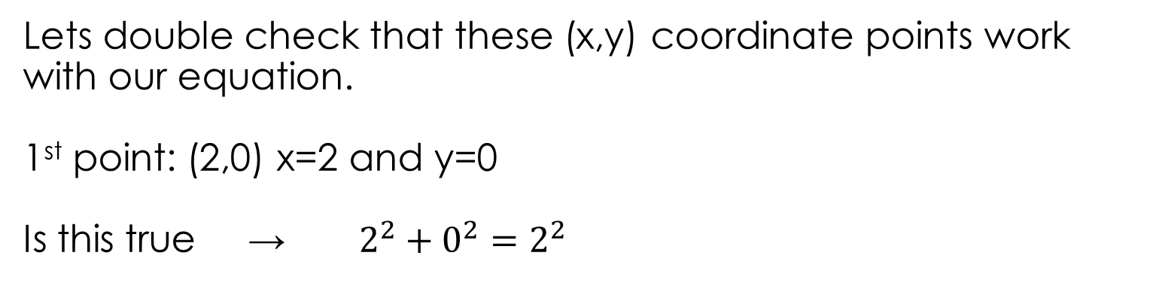


Topic : Circles
How are circles graphed?
equation
$$x^{2}+y^{2}=r^{2}$$
r is the radius and the centre is at (0,0)
Example 1
$$x^{2}+y^{2}=4$$
What is the radius?
$$\sqrt{4}=2$$
We know the centre would still be at (0,0) because no transformations have been made. And we know 4 coordinate points to sketch it.
so: (2,0) (0,2) (-2,0) and (0,-2)
Lets double check that these (x,y) coordinate points work with our equation.
1st point: (2,0) x=2 and y=0
Is this true → $2^{2}+0^{2}=2^{2}$
Try the other points
YES!!!!!!

Slide 5
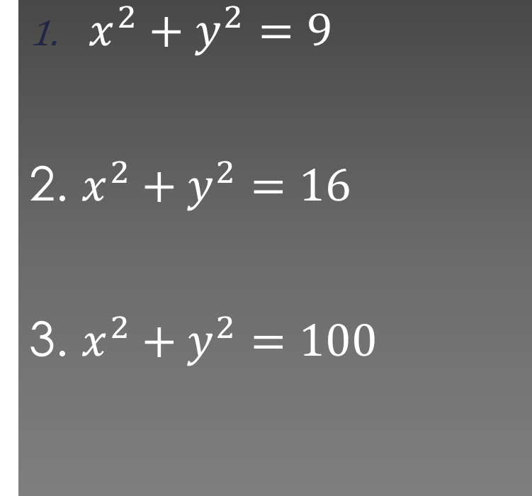
What will the radius be for these circle equations?
$x^{2}+y^{2}=9$
2. $x^{2}+y^{2}=16$
3. $x^{2}+y^{2}=100$
3
4
10

Slide 6
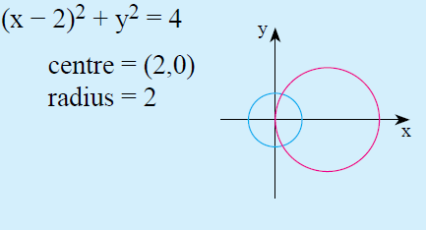
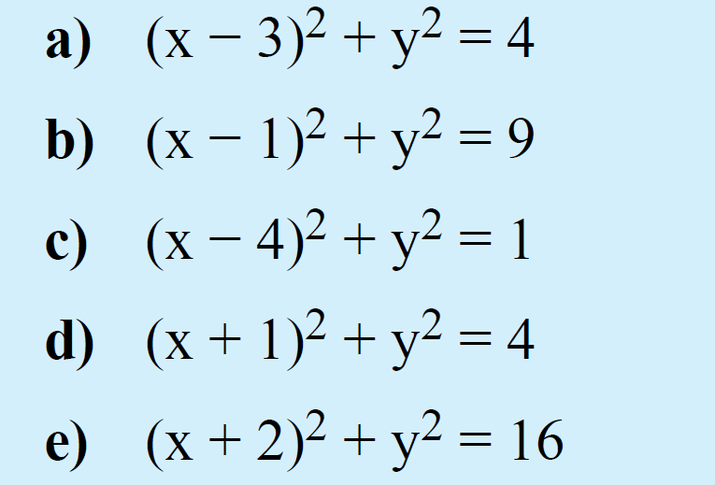
Topic : Circles
How are circles graphed?
How can we shift the circles horizontally?
Which variable is the horizontal one?
X
${(x−p)}^{2}+y^{2}=r^{2}$ shifted p units to the right
${(x+p)}^{2}+y^{2}=r^{2}$ shifted p units to the left

Slide 7
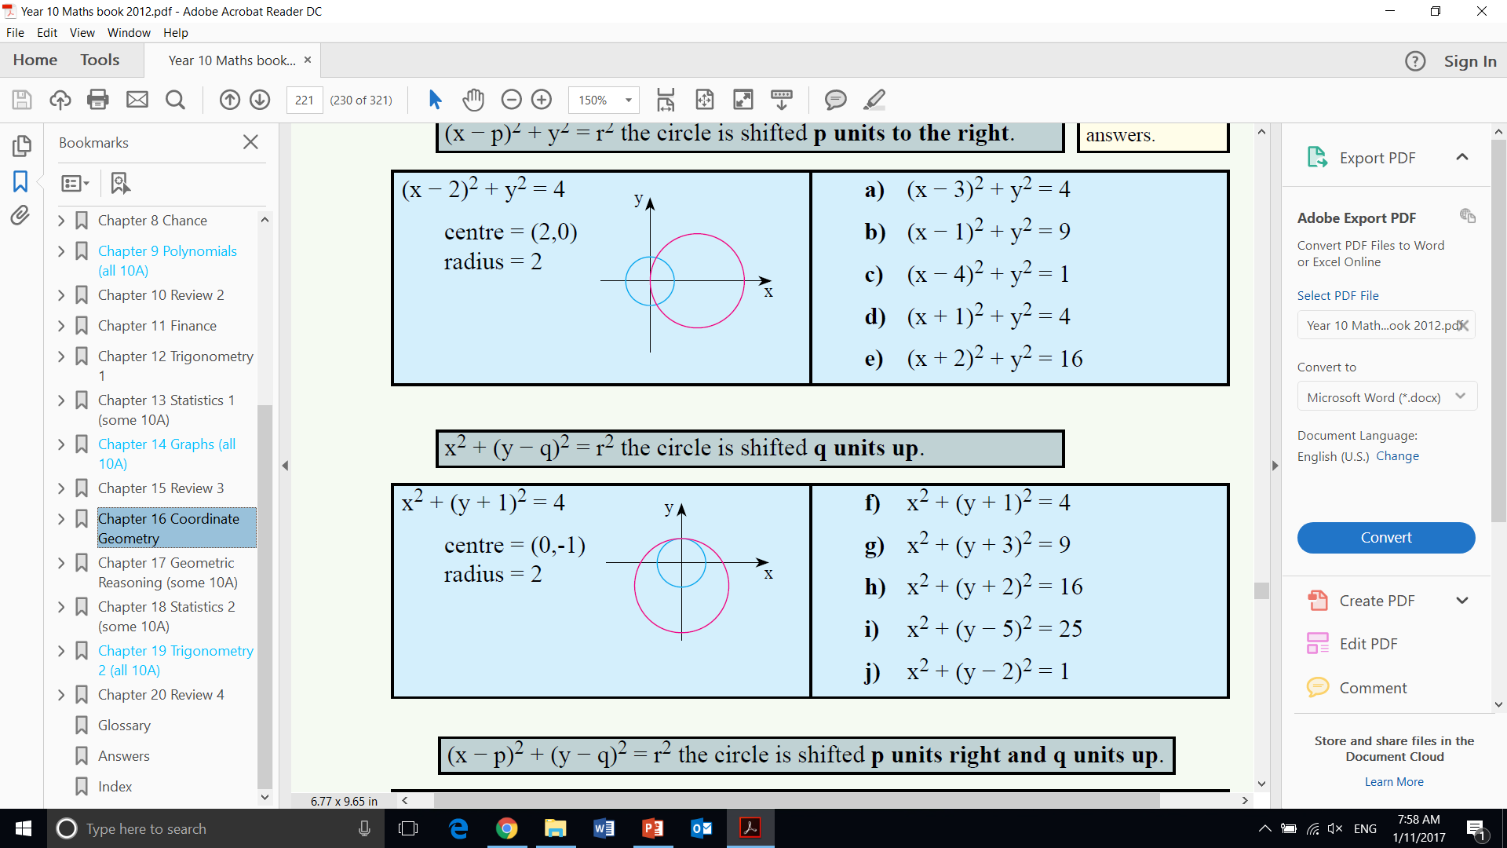
Topic : Circles
How are circles graphed?
How can we shift the circles up?
Which variable is the vertical one?
y
$x^{2}+{(y−q)}^{2}=r^{2}$ shifted q units up
$x^{2}+{(y+q)}^{2}=r^{2}$ shifted q units down

Slide 8
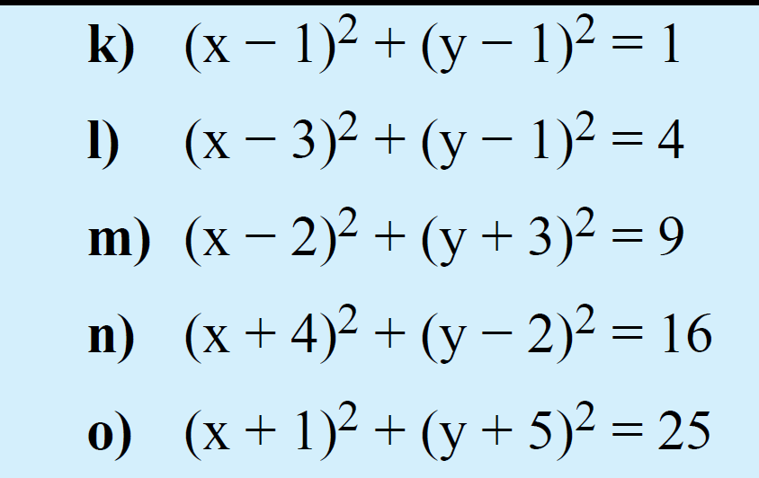
Describe the transformation

Slide 9
Write your summaries

